Slide 1

MLOps minutes
Train
Guillaume Chervet

Slide 2
Extraction
Dataset pdfs
DataSplit
Train
Dataset labels
Le MLOps est une aventure Humaine – Guillaume Chervet

Slide 3
Rank-1 tensors
x = np.array([18,3,6,14])
x.dim
>>> 1

Slide 4
Rank-2 tensors
x = np.array([[18,3,6,14],
[17,1,0,91],
[16,0,0,82]])
x.dim
>>> 2

Slide 5
Rank-3 tensors
x = np.array([[[18,3,6,14],
[17,1,0,91],
[16,0,0,82]],
[[18,3,6,14],
[17,1,0,91],
[16,0,0,82]],
[[18,3,6,14],
[17,1,0,91],
[16,0,0,82]]])
x.dim
>>> 3

Slide 6

Layer 1
Layer 2
Layer …
Layer N-1
Layer N
Cat
Dog
Other

Slide 7
Layer 1
Layer 2
Layer …
Layer N-1
Layer N
Cat
Dog
Other

Slide 8

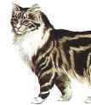

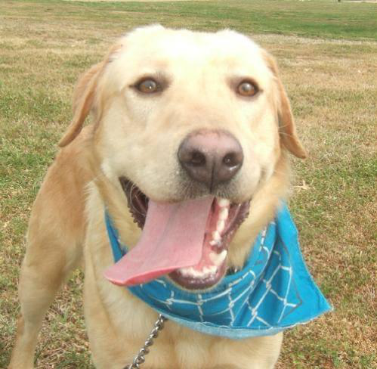
Predictions Groudtruth
Layer 1 Data transformation
Layer … Data transformation
Layer 2 Data transformation
Layer N-1
Data transformation
Layer N
Predictions
Loss Function
Loss Score
Optimizer
Update Weight

Slide 9
Loss value
Parameters value

Slide 10
Loss value
Derivative
Parameters value

Slide 11
Learning rate
Starting point
Loss value
t=0
t=1
t=2
t=3
Parameters value

Slide 12
Velocity
Local
minimum
Loss value
Local
minimum
Global
minimum
Parameters value

Slide 13
Conclusion
Le MLOps est une aventure Humaine – Guillaume Chervet

